Slide 1
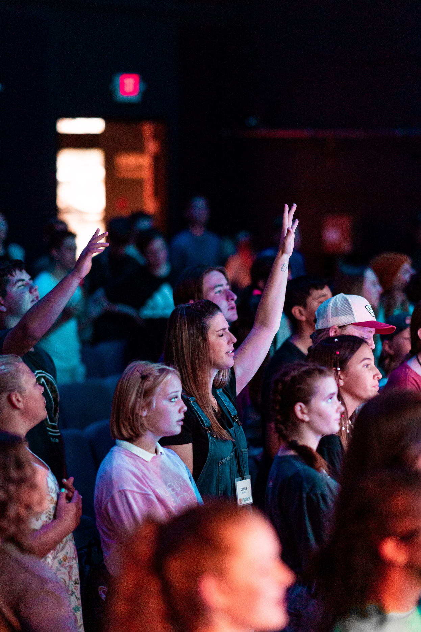


JANUARY 2026
2 Citywide Prayer Events
Celebrate, Worship, Intercede

Slide 2
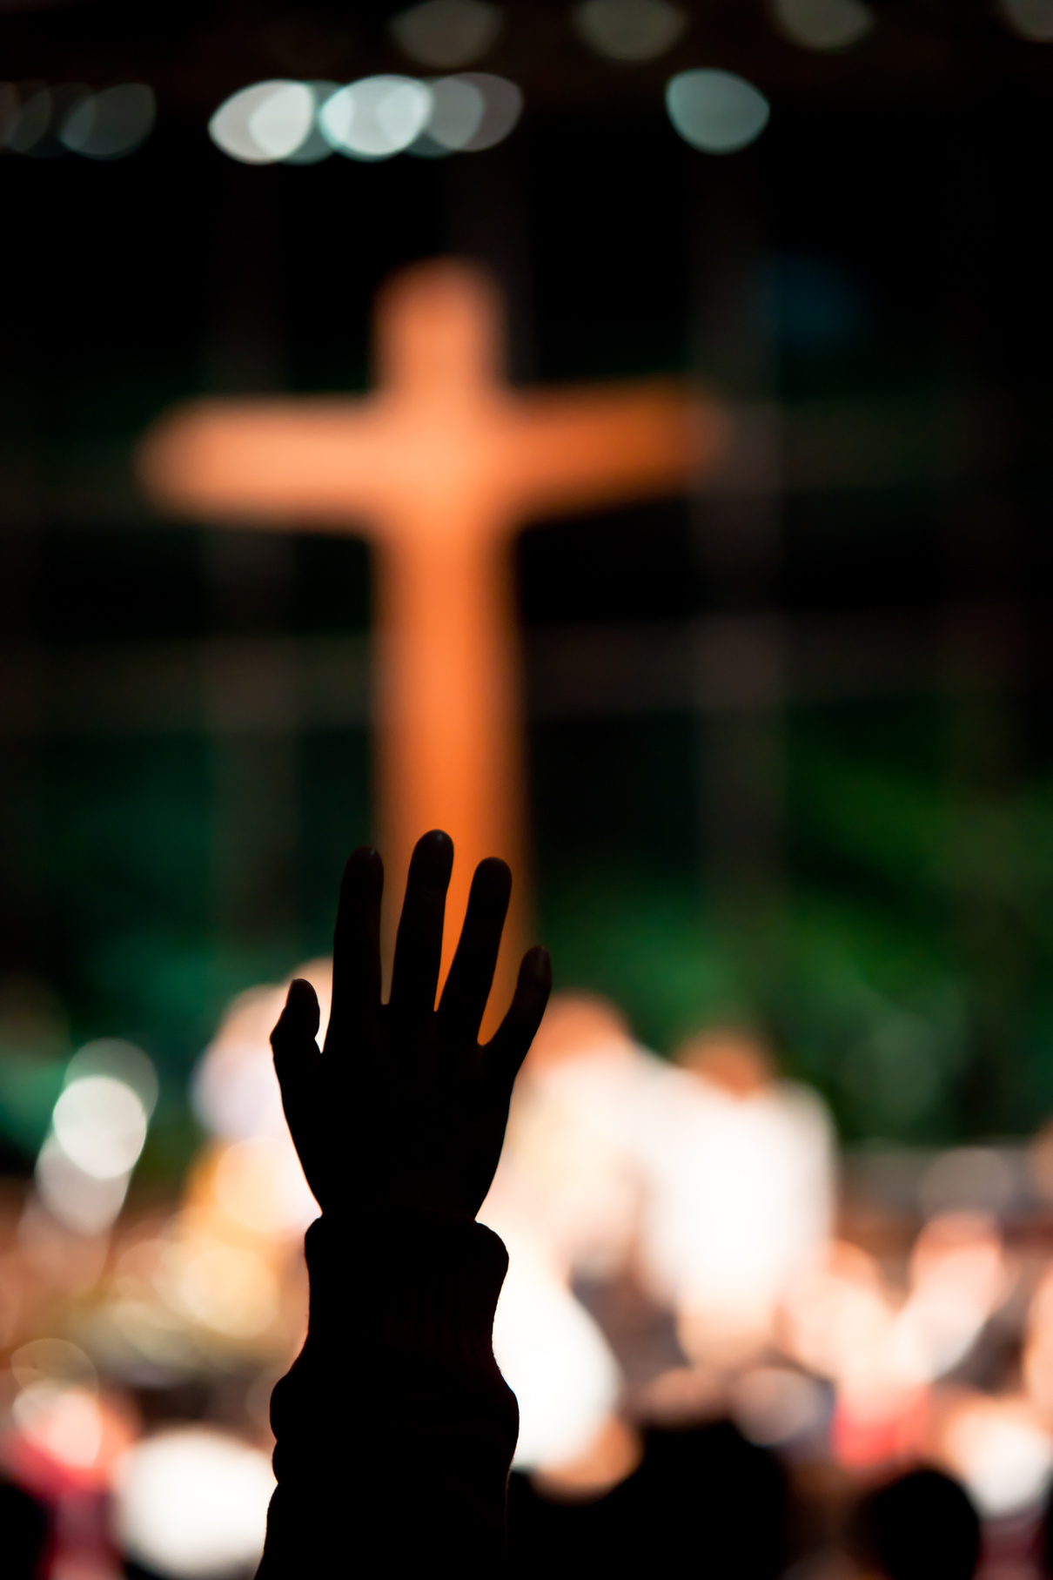
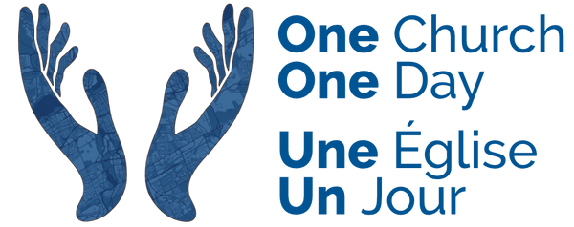
One Church - One Day Launch Night
January 9th, 7 pm
Officially launching 24/7 strategic prayer over Ottawa
26 churches already participating
Evening of Worship, Testimonies, and United Prayer for Ottawa
Where:
Cedarview Alliance Church
Join us!

Slide 3
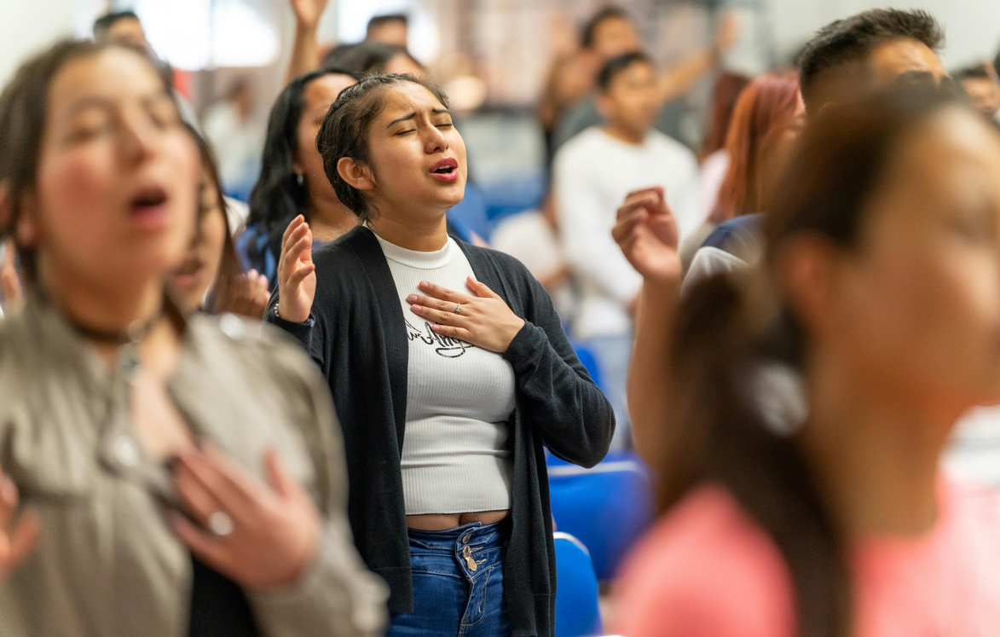
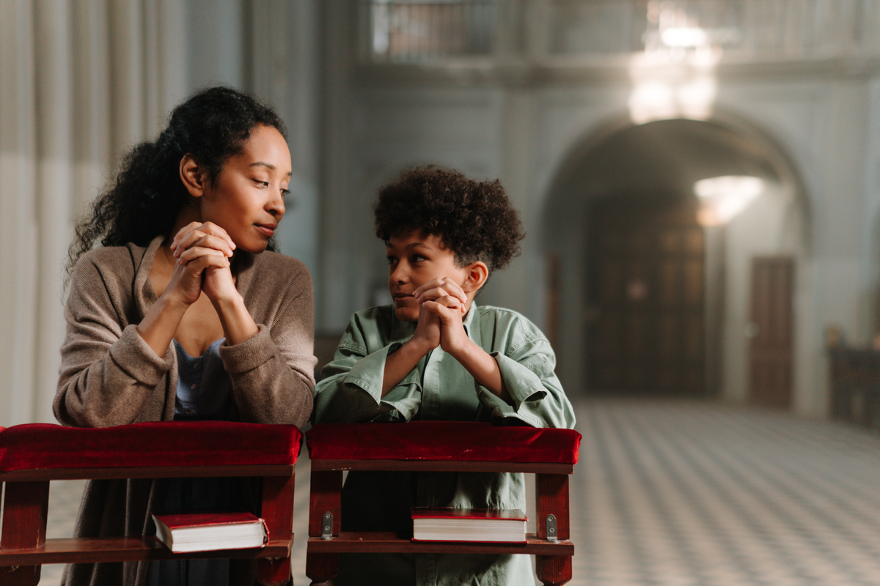
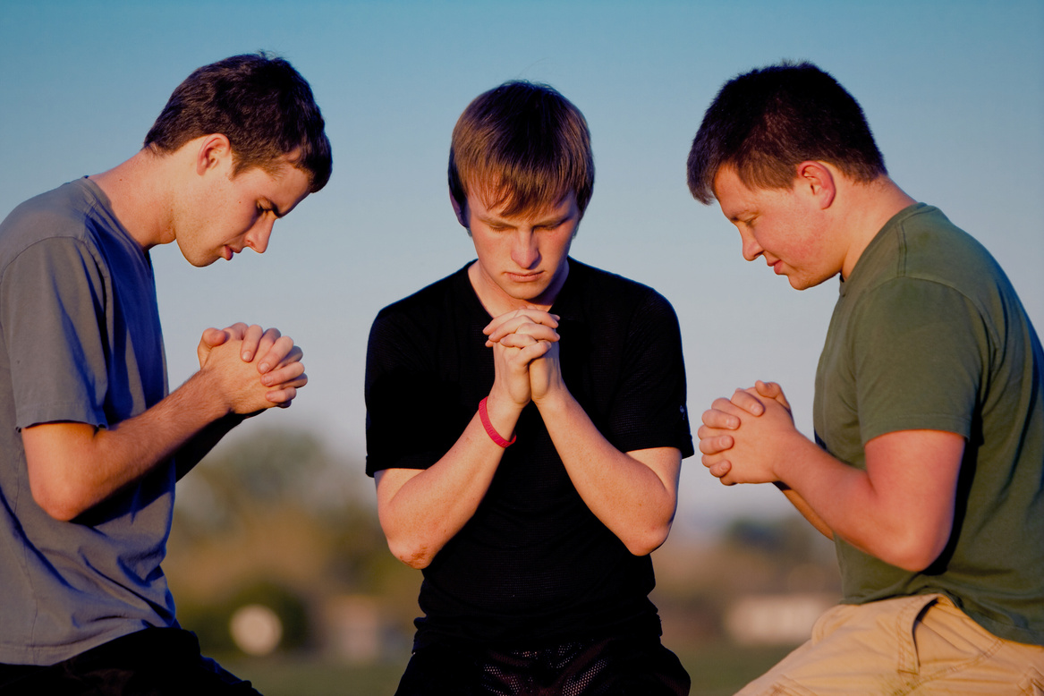

City On Our Knees
10th Anniversary
January 18-24, 2026
Week of prayer for our city!
Map it. Pray it. Join in.
CityOnOurKnees.ca

